Slide 1
Music Rater (Melodi)
–
Status for 10/14/2024
Adrianna Bordonaro, Project Manager
adrianna.bordonaro1@marist.edu

Slide 2
Executive Summary
Complete: FR1 User profiles
On schedule: UX/UI, beginning FR2
In progress: N/A
At risk: N/A
Complete: User profile pictures and usernames, multi platform sign in

Slide 3
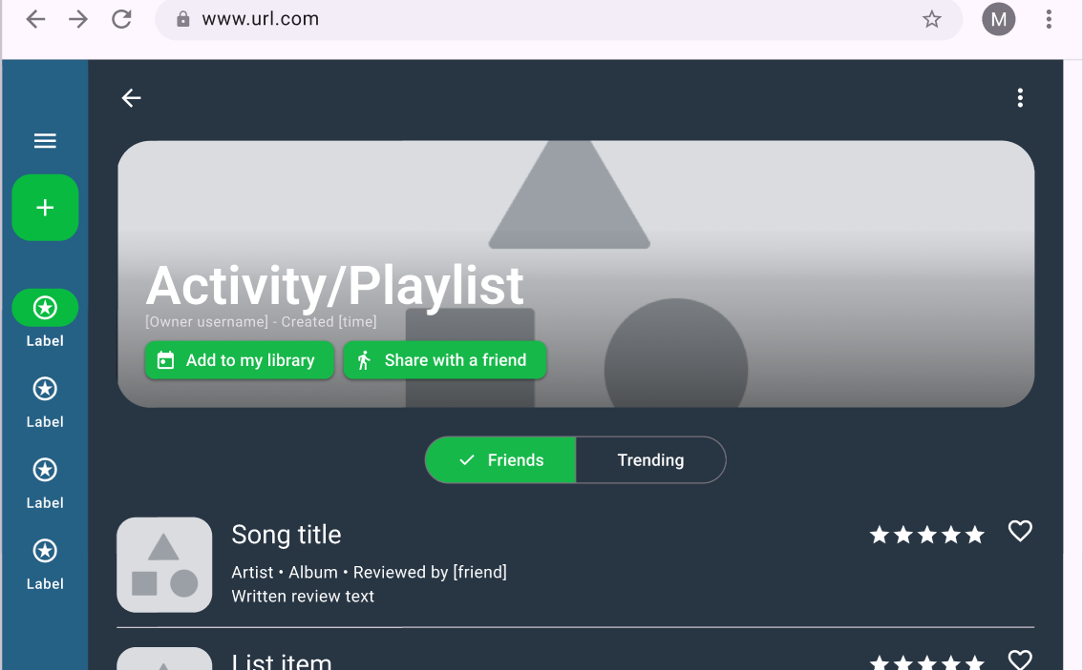
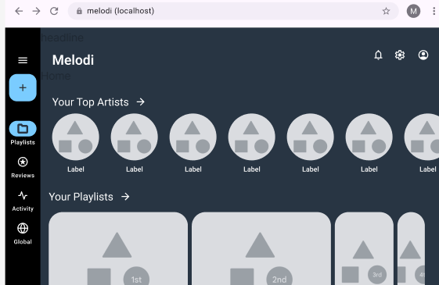
Status Details
Profile photos complete (S3)
Beginning to work with pulling Spotify data
UX/UI
New color scheme
WCAG contrast guidelines

Slide 4
Next Steps / Actions
Implement UX/UI
Work on FR2 (creating and sharing playlists)
Non-functional requirements (accessibility, security)

Slide 5
Thank you
Questions?

